Slide 1
Customer Segmentation Analysis

Slide 2
Contents
About Database
Problem Statement
Tasks Given By PAT Team
Tools
Steps Of Solving Tasks
Dashboard

Slide 3
About Dataset
This dataset contains shopping information from 10 different shopping malls between 2021 and 2023.
We have gathered data from various age groups and genders to provide a comprehensive view of shopping habits in Istanbul.
The dataset includes essential information such as invoice numbers, customer IDs, age, gender, payment methods, product categories, quantity, price, order dates, and shopping mall locations.

Slide 4
Problem Statement
Identification of homogeneous segments of customers based on their similar characteristics.
Finding the insights from the data.

Slide 5
Tasks Given By PAT Team
How is the shopping distribution according to gender?
Which gender did we sell more products to?
Which gender generated more revenue?
Distribution of purchase categories relative to other columns?
How is the shopping distribution according to age?
Which age cat did we sell more products to?
Which age cat generated more revenue?
Distribution of purchase categories relative to other columns?
Does the payment method have a relation with other columns?
How is the distribution of the payment method?

Slide 6
Tools
Mysql
Excel
Power Bi

Slide 7
Steps of Solving Tasks
Step 1:
Extracting data from mysql server
At the first day we creating a new connection in mysql workbench using given credentials.
For extracting we used extract option in mysql workbench.
Step 2:
After extracting data we checks that the given data is cleaned or not
According with system date format we changed datatype of “invoice_date”.

Slide 8
Steps of Solving Tasks
Step 3:
After cleaning data we uploaded it to power Bi
We custom new column like year, age group, ect,
Step 4:
We start to visualize
During visualize we uses bar charts, Pie chart, Donut chart, Slicers
And finally we created one dashboard

Slide 9
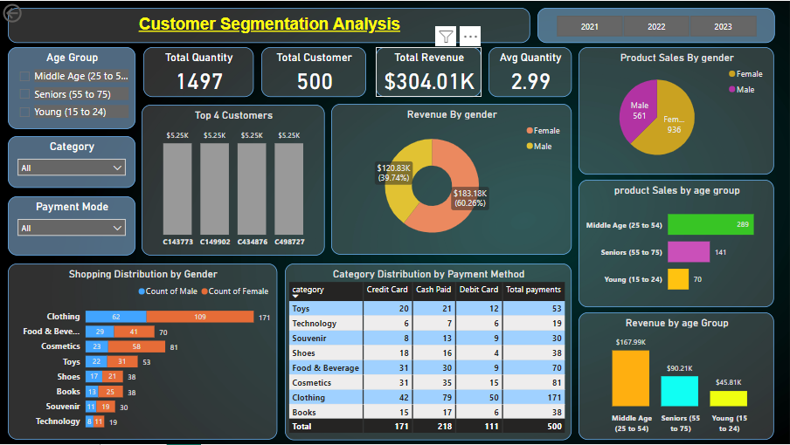
Dashboard

Slide 10
Thank You !

